Slide 1
CDNs and Privacy Threats: A Measurement Study
Akash Levy
Adviser: Prateek Mittal
Second Reader: Arvind Narayanan
Senior thesis presentation

Slide 2
Motivation
Lots of third-parties delivering content
What information is learned when we visit sites on which they deliver content?
How much can these third-parties learn about a user’s behavior?

Slide 3
Threat Model
Users interact with first-party website
CDNs and other third-parties observe metadata associated with these interactions
CDNs can collect and leverage information on end users based on this metadata

Slide 4
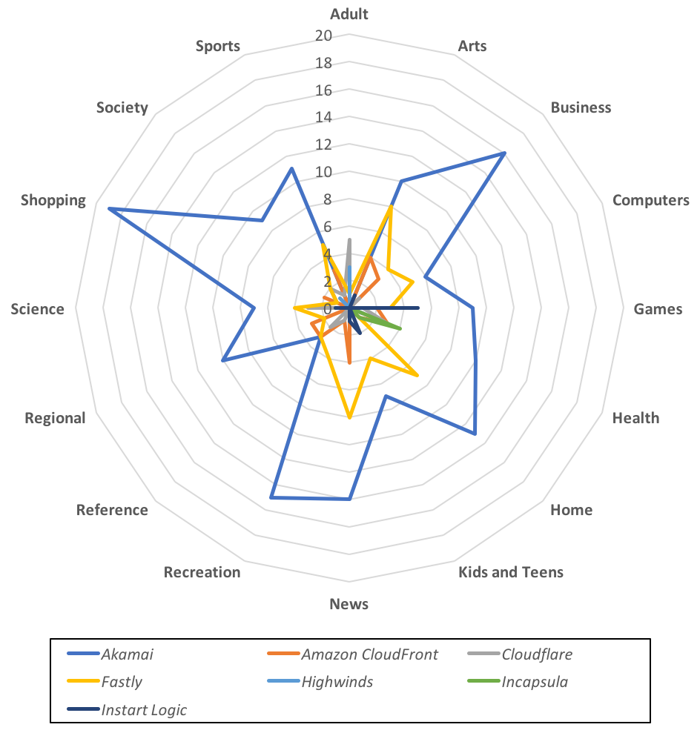
CDN Specialization

Slide 5
Related Work: OpenWPM, Online Tracking: A 1-million-site Measurement and Analysis
https://webtransparency.cs.princeton.edu/webcensus/
A measurement framework for collecting and analyzing tracking patterns across the top-million sites
Collects all requests triggered by page load and monitors Javascript behavior
Gives a picture of tracking behavior on the wider Internet

Slide 6
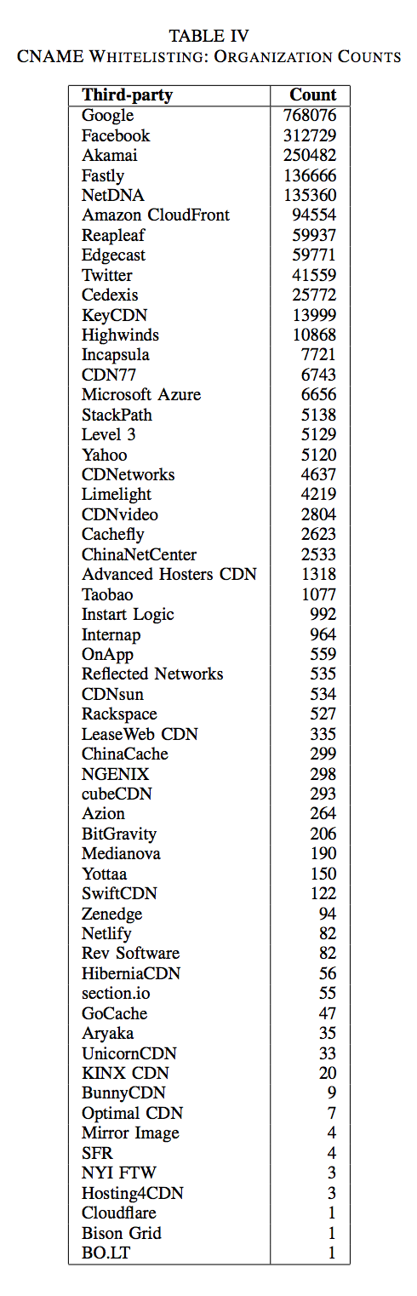
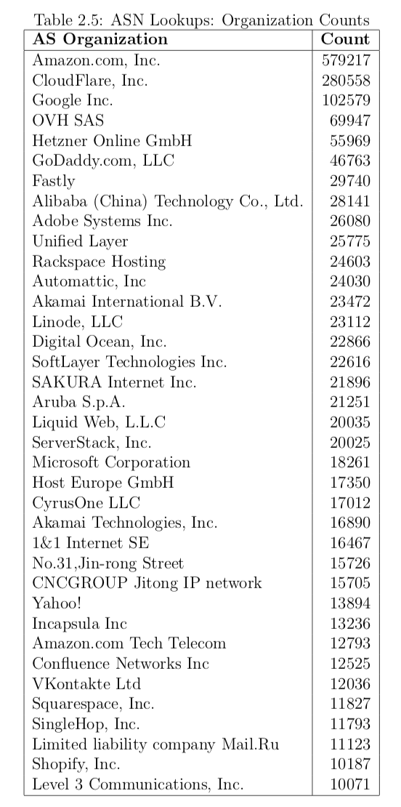
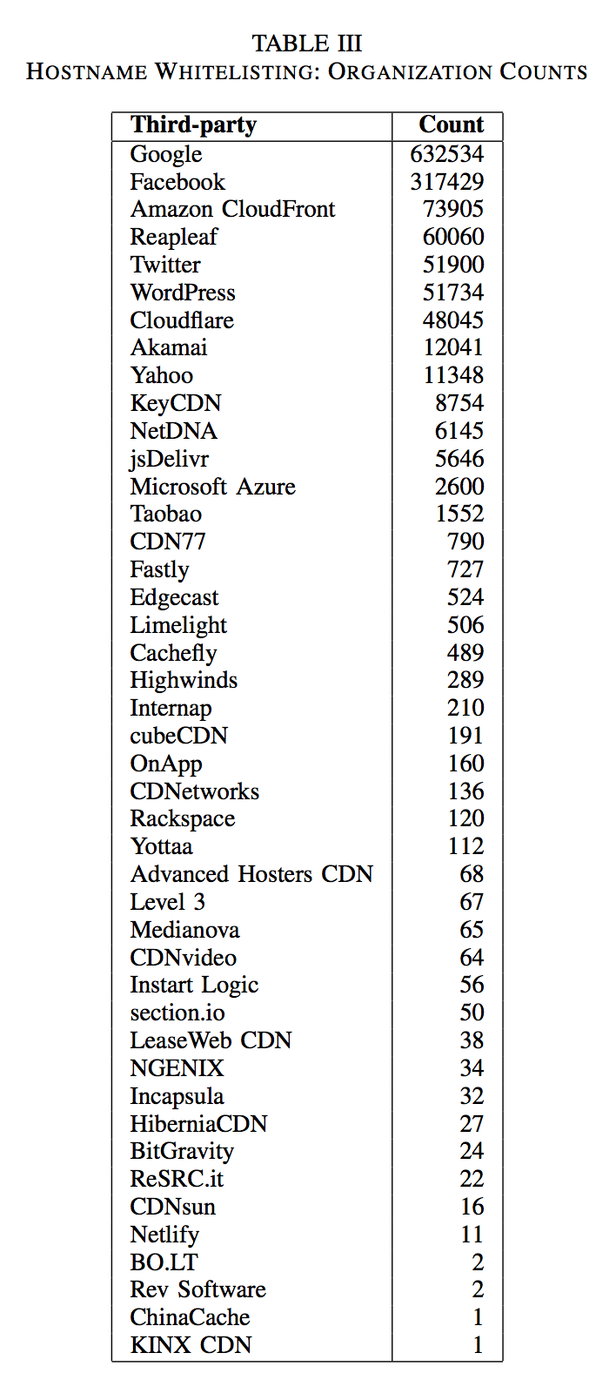
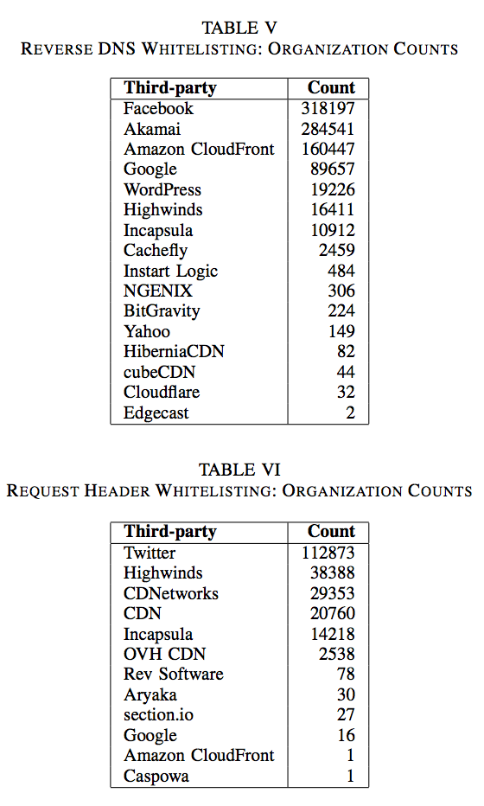

Slide 7
CDN Measurement Techniques: Cross-Analysis

Slide 8
How Referer Headers Work
Client makes request to an origin server
The response may contain references to third-party content
The browser makes requests to these third-parties and by default includes a Referer header that leaks the full URL of the page the user was visiting

Slide 9
Referrer Policy and Measurement
enum ReferrerPolicy {
"",
"no-referrer",
"no-referrer-when-downgrade",
"same-origin”,
"origin",
"strict-origin",
"origin-when-cross-origin",
"strict-origin-when-cross-origin",
"unsafe-url”
};
Findings:
Only 1732 top-million websites use referrer policy
Only 628 use a safe referrer policy
R² = 0.81

Slide 10
CORS Policy and Measurement
Cross-Origin Resource Sharing
Defines how dynamic requests are handled
Includes an Origin header that only gives away the root domain of visited webpage
Better default policy than Referer header’s
Findings:
Only 5798 top-million websites use a specific CORS Policy
R² = 0.97

Slide 11
Resource Heterogeneity

Slide 12
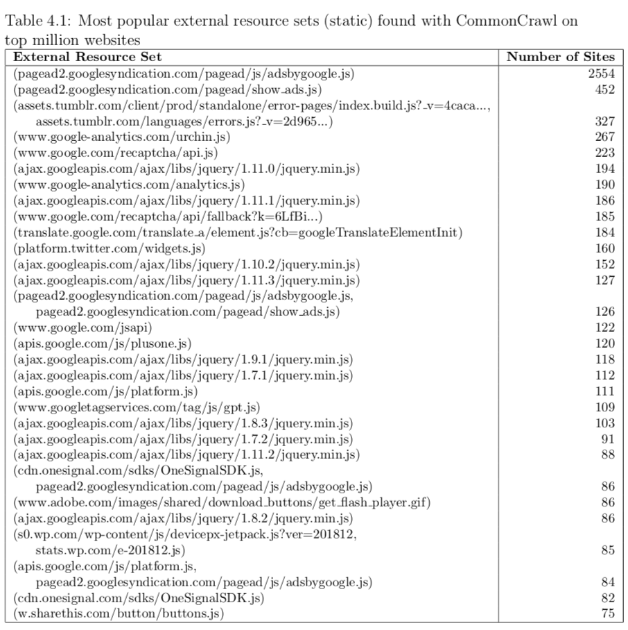
Resource Heterogeneity

Slide 13
Contributions & Conclusion
CDN specialization
Weak referrer policy is prevalent on the Internet
Browsing metadata (including history) is routinely leaked to third-parties without the use of cookies
Resource heterogeneity: third-party fingerprinting without Referer headers

Slide 14
More Conclusions
Disable Referer header by default?
Too many economic incentives for Internet tracking
OpenWPM can track methods, but we will have to continually work to do it
Need to develop low-latency privacy-enhancing technologies

Slide 15
Thank you!
Questions?

